Slide 1
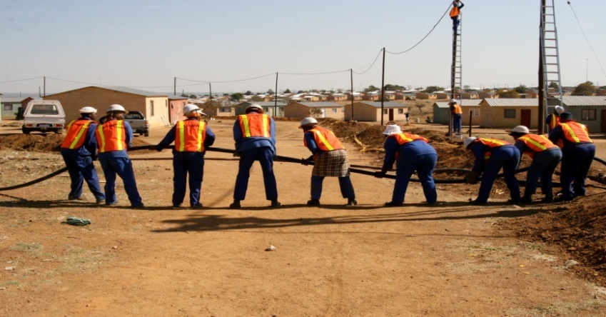
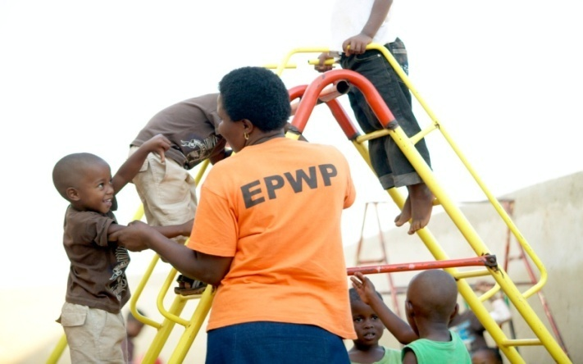
Expanded Public Works Programme 2018 Summit Commission 4: Compliance, Monitoring and Reporting Feedback

Slide 2
Commission 4: Compliance, Monitoring and Reporting
Issue | Action | Responsibility | Time Frames
1. Recruitment of EPWP Participants: How do we enforce compliance to the recruitment guidelines in ensuring fairness in the recruitment process? | Workshop Councillors on the Recruitment Guidelines – Consider having a policy on the EPWP instead of Guidelines. Establish project steering committees for all EPWP projects to enhance the transparency of recruitment processes. Upon registration of a project into the EPWP-RS, upload a copy to confirm recruitment was undertaken following the EPWP Recruitment Guidelines. Social Facilitators should be enhanced to assist with recruitment processes in EPWP projects. | NDPW Public Bodies Public Bodies Public Bodies | Ongoing Ongoing Ongoing Ongoing

Slide 3
Commission 4: Compliance, Monitoring and Reporting
Issue | Action | Responsibility | Time Frames
1. Recruitment of EPWP Participants: How do we enforce compliance to the recruitment guidelines in ensuring fairness in the recruitment process? | To avoid recycling of participants into the programme, collect data on the employment history of participants for monitoring purposes. In addition to the EPWP Recruitment Guidelines, develop Standard Operating Procedures (SOPs) on the recruitment processes to be followed in the EPWP. | Public bodies NDPW | Ongoing EPWP Phase 4

Slide 4
Commission 4: Compliance, Monitoring and Reporting
Issue | Action | Responsibility | Time Frames
2. Compliance to audit requirements: How to improve compliance to the Auditor General’s requirements on EPWP Projects? | Conduct physical verification of projects and validations of documents. Internal audit units of public bodies must conduct quarterly audits to prepare public bodies for audits. Develop a framework on EPWP implementation of the programme and processes to be followed. Ensure EPWP specifications and required documentation are specified in the tender document and contracts – no payment to be processed without the POEs. Create/utilise information management units to assist with verification of documents for projects implemented. Ensure that all public bodies APPs include EPWP targets. | NDPW NDPW & Provincial Coordinating Departments NDPW All Public Bodies, Coordinating Departments & DPW All public bodies NDPW supported by public bodies | March 2019 Quarterly – Starting from November 2018

Slide 5
Commission 4: Compliance, Monitoring and Reporting
Issue | Action | Responsibility | Time Frames
2. Compliance to audit and safety requirements: How to improve compliance to the Auditor General’s requirements on EPWP Projects? | Revise the IG Framework to include the withdrawal of the grant if public body is non-compliant on IG funded project. Provision of technical support to public bodies on records management to be continued. EPWP Auditing and Public Body performance audit to be conducted simultaneously. Develop a Knowledge Management system to allow public bodies to upload source documents required for audits. | NDPW NDPW NDPW & AGSA | EPWP Phase 4 Ongoing Ongoing EPWP Phase 4
 | Engage Treasury and Auditor General to develop an EPWP Accounting Framework | AGSA, Treasury and DPW | EPWP Phase 4

Slide 6
Commission 4: Compliance, Monitoring and Reporting
Issue | Action | Responsibility | Time Frames
3. Improved Reporting: How to simplify reporting system and requirement? | Develop clear templates for reporting of outputs in the EPWP. Include EPWP in the performance agreements of senior management of public bodies. | NDPW Public Bodies | EPWP Phase 4

Slide 7
I thank you

